Slide 1
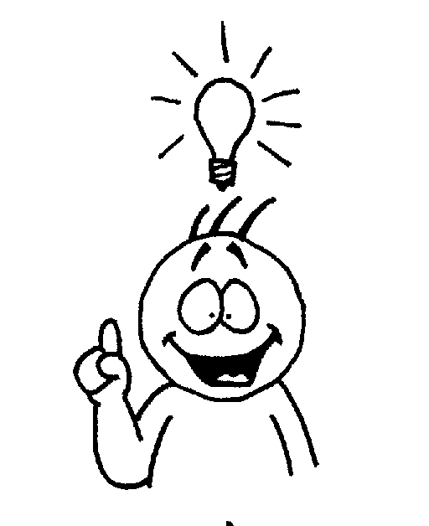
Literary Terms

Slide 2
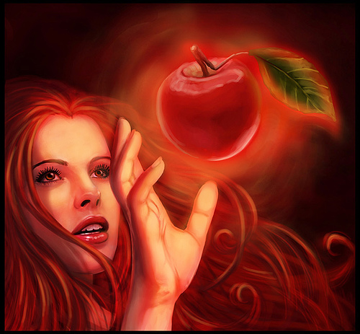
Allusion – a reference made to a well known literary, artistic, political, or historical idea. This is used to highlight a feeling or point in a work of literature.
The child wanted the candy from the jar on top of the refrigerator, but it was the forbidden fruit.

Slide 3
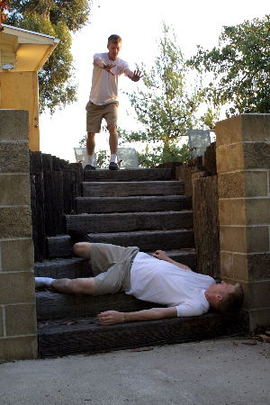
Antagonist – One who opposes the protagonist

Slide 4
conflict
to struggle or clash against an opposing force
In literature this refers to the problem that drives the work:
Man vs. Man
Man vs. Nature
Man vs. Himself

Slide 5
Connotation
The associated/ second meaning that comes with a word or group of words

Slide 6
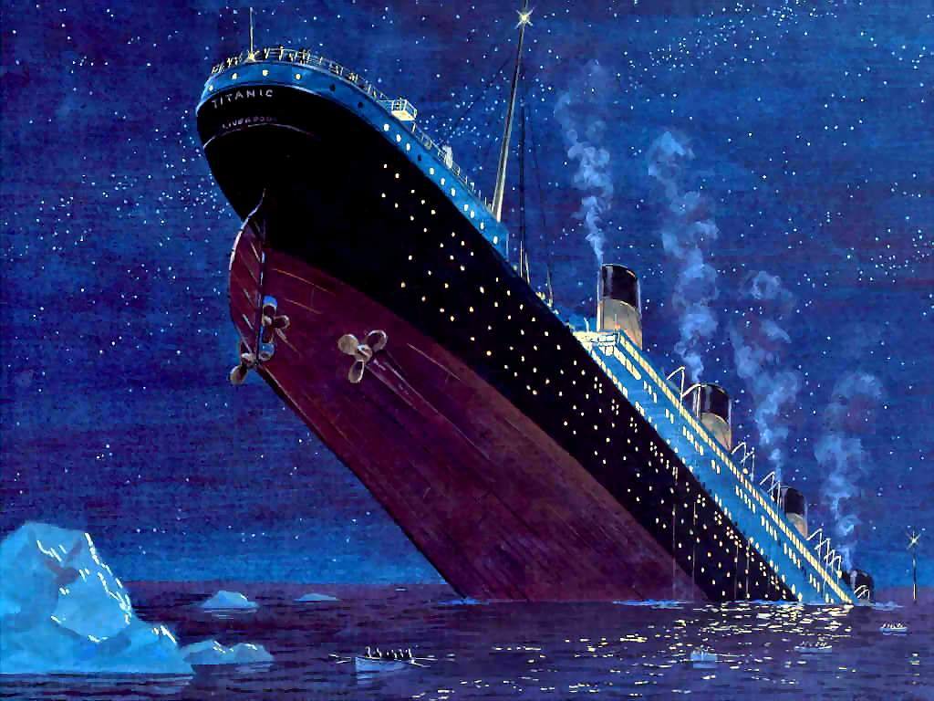
Dramatic Irony
The audience knows what will happen but the characters do not

Slide 7
Extended Metaphor
Metaphor introduced and developed through a piece of literature

Slide 8
The Road Not Taken - Robert Frost
Two roads diverged in a yellow wood, And sorry I could not travel both And be one traveler, long I stood And looked down one as far as I could To where it bent in the undergrowth; Then took the other, as just as fair, And having perhaps the better claim Because it was grassy and wanted wear, Though as for that the passing there Had worn them really about the same, And both that morning equally lay In leaves no step had trodden black. Oh, I kept the first for another day! Yet knowing how way leads on to way I doubted if I should ever come back. I shall be telling this with a sigh Somewhere ages and ages hence: Two roads diverged in a wood, and I, I took the one less traveled by, And that has made all the difference.
Where is the extended metaphor in here? What is being compared throughout the entire work?

Slide 9
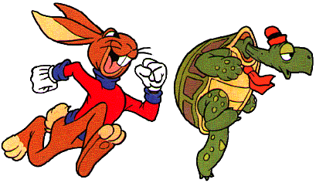
fable
Short tale meant to teach a moral lesson

Slide 10
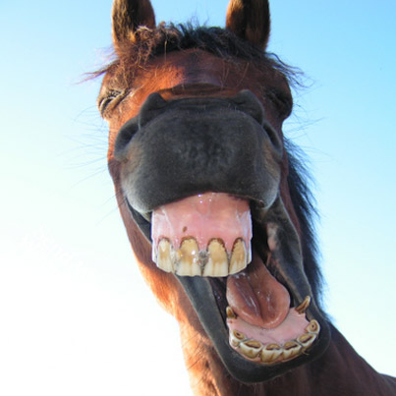
Figurative Language
An expression; not to be taken seriously.
I’m so hungry, I could eat a horse.

Slide 11
Foil
A character who
Contrasts another in a
Story, meant to highlight
A glaring concept/emotion

Slide 12
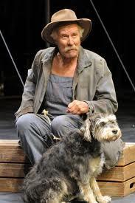
Foreshadowing
Scenes or quotes provided by the author meant to explain scenes later in the work

Slide 13
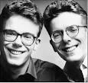
Hyperbole
Intentional exaggeration used in a piece of literature
“I would walk 500 miles, and I would walk 500 more just to be the man…”
-The Proclaimers

Slide 14
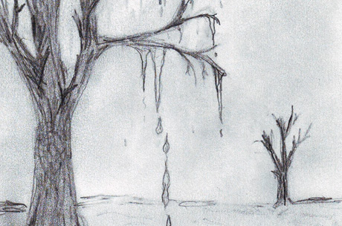
Imagery
Descriptive language that creates a visual picture in the reader’s mind

Slide 15
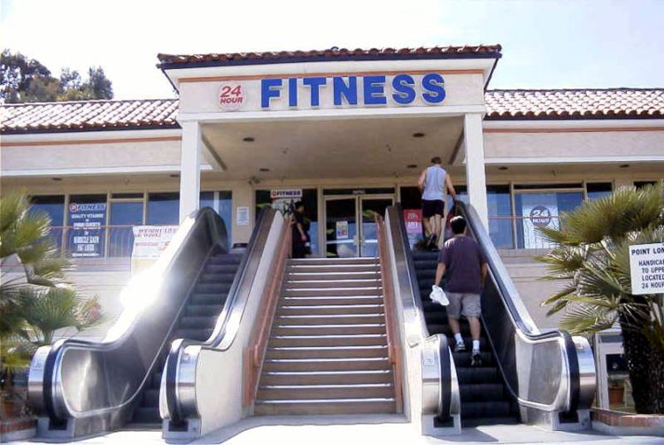
Irony

Slide 16
Irony (continued)
A discrepancy between what is said and what is done
Two animal rights activists were protesting the cruelty of sending pigs to the slaughterhouse in Nebraska. Suddenly the pigs, all 2,000 of them, escaped through a hole in the fence trampling both activists in the process.

Slide 17
Metaphor
A term or phrase applied to something that is not comparable to suggest a resemblance
He is a lion in battle.

Slide 18
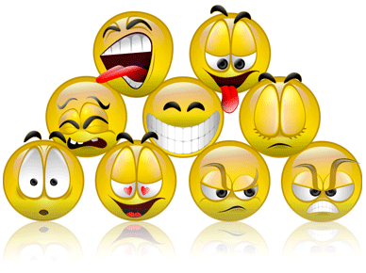
Mood – the prevailing emotional tone presented in a literary work through the description of characters and setting

Slide 19
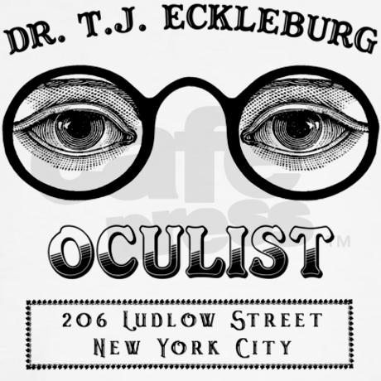
Motif
Recurring theme, symbol, or subject placed within a novel meant to teach a deeper truth

Slide 20
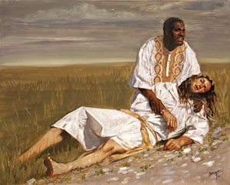
parable
Short tale meant to teach a lesson; Biblical tales are good examples of parables

Slide 21
Paradox
A contradictory statement meant to express a possible truth.
“That government is best which does not govern at all” (Thoreau)

Slide 22
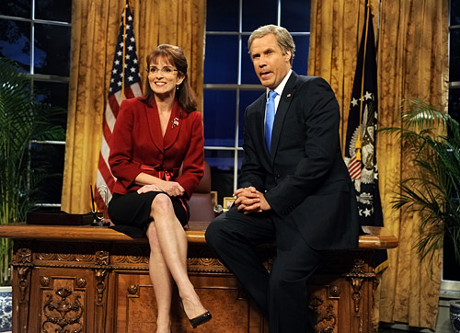
Parody
Comical imitation of a piece of literature, politics, or media

Slide 23
Protagonist – usually the hero; the one who drives the action

Slide 24
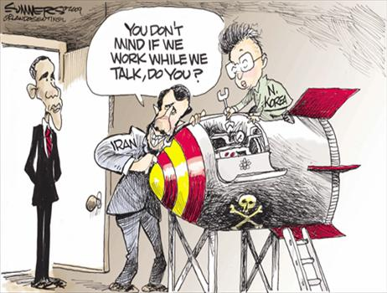
Satire
A piece of art that discusses a social flaw through mockery or sarcasm
Mark Twain’s “The lowest animal” is a sarcastic short story that claims that humans are a lower species than animals in various ways

Slide 25
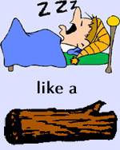
Simile
Comparing two unlike things using “like” or “as;” a direct comparison
Sleeping like a log →

Slide 26
Stream of Consciousness
Writing style where the author seems to be speaking in an unformed/ unstructured way; inner monologue
(Sprint writing exercises)

Slide 27
Symbolism
An object, color, or character who represents something deeper in a piece of literature
The scarlet “A” Hester had to wear

