Slide 1
Satire

Slide 2
Aim of Satire
As a literary technique, the writer attempts to expose/criticize some sort of shortcoming or corruption in the society around him. The hope is that this work may instill change in humanity through it.
Humor is often the main avenue used (light material is easier to accept than dark, ominous material)
-Verbal Irony – What is said is not necessarily what is meant (sarcasm).
Fictional characters represent real people in an obvious way
The piece chooses the main follies or flaws in the topic

Slide 3
Why is satire vital/appropriate for the Us?
We are a land of free speech…we have the right to criticize openly.
Some cultures despise us because we have this right.
This literary technique can be so powerful that it costs some people their lives…
http://www.businessinsider.com/history-of-how-charlie-hebdo-became-a-top-terrorist-target-2015-1
12 People lost their lives in a terrorist attack because they published satirical images of Islamic idols.
“The pen is mightier than the sword”…What does this mean? How is this possible?

Slide 4
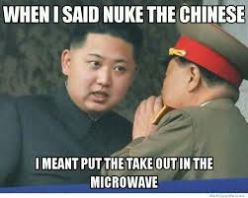
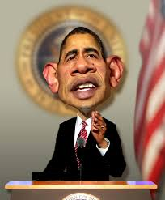
Exaggeration
-represents something beyond normal bounds so that it becomes ridiculous and its faults can easily be seen
Caricature – physical features or traits exaggerated
Burlesque – exaggeration of language

Slide 5
Incongruity
Things portrayed are absurd or out of place in relation to their surroundings
Charlie Chaplin’s The Great Dictator globe scene
How is this an example of incongruity?
https://www.youtube.com/watch?feature=player_detailpage&v=YqyQfjDScjU

Slide 6
Parody
Imitates the style of some person, place, or thing to RIDICULE the original.
**** For parody to be correctly used, the viewer/reader must know the original person/text being ridiculed!!!
SNL clip of Will Ferrell as George Bush… ‘nuff said!

Slide 7
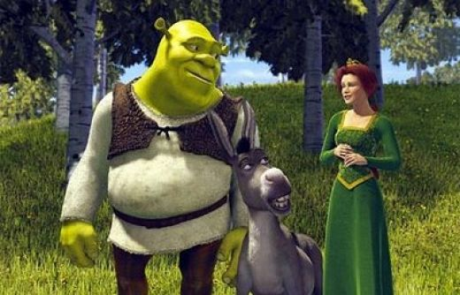
Reversal
Presents the opposite of normal order…chronological order, social order, hierarchical order

Slide 8
“A Modest Proposal” -Jonathan Swift
Historical Context:
Written in 1729, takes place in Ireland
English men owned much of the Irish land although they did not live there… “absentee land owners”
At the time, Ireland was overcrowded, famined, weak while England was thriving and becoming culturally powerful
Jonathan Swift actually offered sincere, realistic solutions but was not heard or taken seriously, so he wrote this…

